Slide 2
Succession Planning
Pamela Frizelle
Tracey Kennedy

Slide 3
Why do people volunteer?
Not volunteer?
Feel they don’t have skills/confidence
Not asked or no time
Volunteer?
Social aspect/ new to the area
Their are involved children
To give back

Slide 4
Friendly
Energetic
Supportive
Structured
Club days
Family Orientated
Active
Fair
Enthusiastic
What does a club that promotes volunteerism look like?

Slide 5
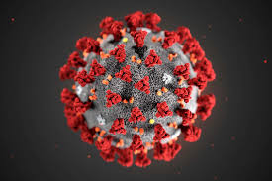
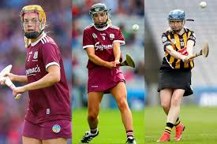
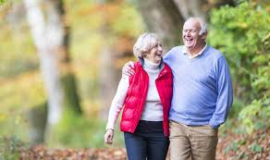
Methods of Recruitment

Slide 6
Methods of Recruitment
Registration Form
Name:
Occupation:

Slide 7
Development

Slide 8
Retention
Respect
Recognition & Reward
Role
Development / Progress

Slide 9
Succession Planning
Clear role descriptors
1
Clear development plan
2
Ensure policies and procedures
3
Monitor and plan for role vacancies
4
Identify volunteer with specific skills
5
Clear success indicators
6

Slide 10
Positives for Succession Planning
Positives
Knowledge preserved
Continuity
Recognition and Reward
Minimise burnout
Develop and train volunteers
Motivate volunteers
Opportunity to attract young people
Match skills for each role
Clear support for new volunteers

Slide 11
Challenges of succession planning
Challenges
Inadequate training and development
Limited number of volunteers
Not all members understand benefits of succession planning
Work Overload
Fearful of change
All members may not have shared vision
Poor record keeping and planning
Personalities, ego, personal agendas
Recruitment not transparent

Slide 12
Recruiting and Retaining Volunteers
Questions?
Volunteers don’t get paid, not because they’re worthless, but because they’re priceless.” - Sherry Anderson

