Slide 2
Go Games – The What, The Why and The How Stuart Reid

Slide 3
Go Games – What does it stand for?
Answer – Everyone gets a ‘Go’ for the entire ‘Game’

Slide 4
Go Games – What is the ethos?
Two key objectives of Go Games:
1. Promote Full Participation – SMALLER IS BETTER!
2. Cater for the varying developmental needs of young
players (equipment & rules)
The principle of ensuring that all participants get to play the full game should be set in stone, along with the principle of not awarding medals or trophies

Slide 5
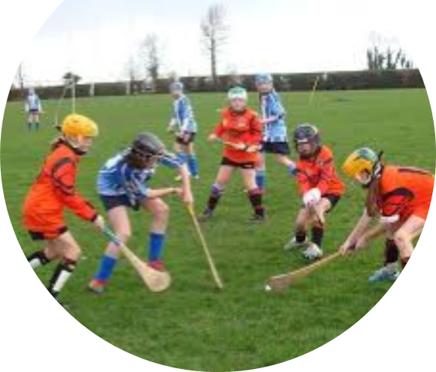
Go Games – What are the benefits?
Research by Niall Moyna (DCU) in 2004
The benefits of Go Games are:
1. Increased enjoyment
2. Increased number of touches on the ball
3. Increased physical work rate
4. Increased perception of competence

Slide 6
Go Games – Why do we play?
Why do children and young people participate in sport?
For fun and enjoyment
To improve their skills
To get fit
To play as part of a team
For the challenge of competition
Why do children and young people drop out of sport?
Pressure to win
Pressure to train
Wanted to do other things

Slide 7
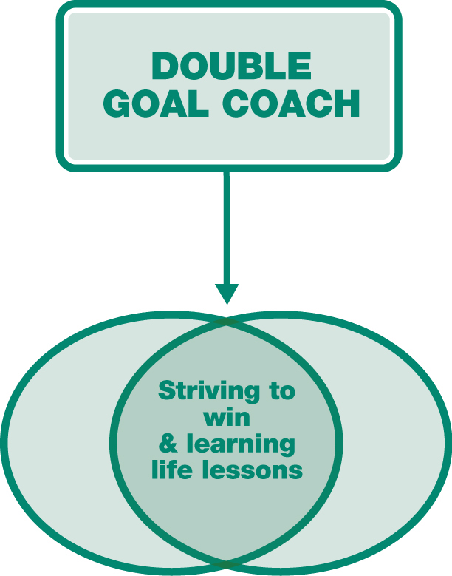
Go Games – The Role of the Coach
Winning
• Learning to compete effectively
• Wanting to win, not at all costs, but through concerted effort
Teaching young people vital life skills through sport
• Leadership Handling adversity
• Teamwork Persistence
• Compassion

Slide 8
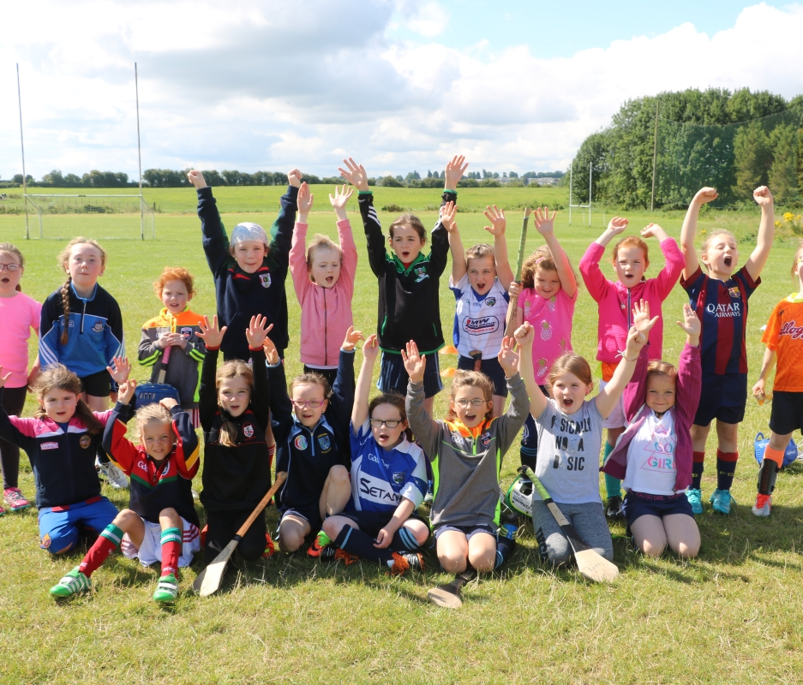
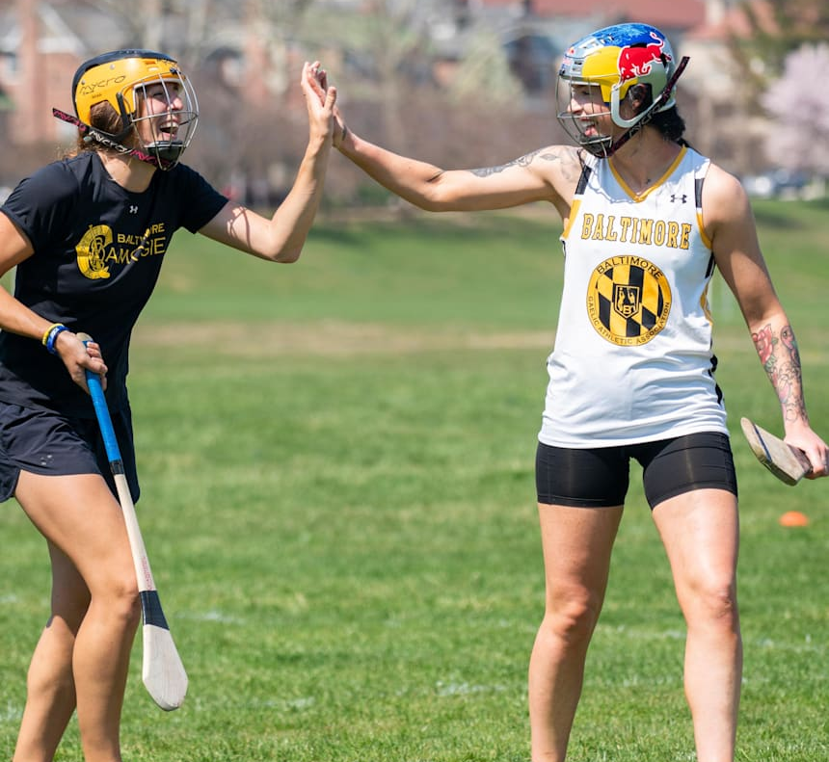
Go Games – The Role of the Coach (& Parent)
Ensure participants have fun
Inspire young people to be the best they can be
in both sport and in life
Recognise that a positive sporting experience can help develop self-confidence and self-esteem
Equip yourself with the most effective methods and practices in your coaching
Success as a coach can ultimately be measured by whether or not participants return to your sessions.

Slide 9
Go Games – How can we do it?
All participants play in the full game
Activities are structured in a manner which optimises the level of fun, friendship, fair play and achievement derived by participants
Participants train and play in a safe, supportive and stimulating environment where they are encouraged to risk error, to learn and to derive maximum enjoyment from their involvement

Slide 10
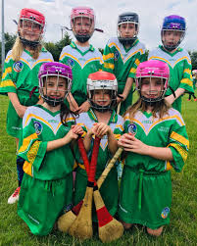
Go Games – How can we do it?
Players master the basic skills of Hurling and Gaelic Football, and experience the sense of accomplishment which derives from acquiring playing proficiency on the left and right hand side of the body
Everybody involved in Go Games should adhere to the key underpinning principles and the GAA ‘Give Respect, Get Respect’ initiative (players, parents/guardians, spectators, mentors, teachers, officials)

Slide 11
Go Games – Coaching Tools
Effort / Stretch Goals
Outcome goals tend to focus on the end result which can sometimes be out of your personal control
Effort goals are motivating because players can control them and can easily see when and where progress is made - this can then lead to outcomes being achieved
Once achieved you can ‘stretch’ the goals to challenge and motivate the players
Outcome Goal = Strike the ball well off both sides
Effort Goal = 1. Correct set up prior to swinging the hurley 2. C-shaped swing 3. Correct ball toss (direction/height)

Slide 12
Go Games – Coaching Tools Effort Log
Coach: |  |  | Session: |  |  |  | Date:
Name | Attendance | Effort | Behaviour | Attitude | Water | Helping others | Teamwork | Encouragement
Player 1
Player 2
Player 3
Player 4
Player 5
Player 6
Player 7

Slide 13
Go Games – Practical Advice for Organisers
Research has proven kids play for fun – winning is not their primary motivation
Research has proven kids prefer playing & losing to winning & not playing
SMALLER IS BETTER - Players cannot improve if they don’t touch the ball!
Less players on the pitch = more player involvement = happier and more competent players
Teams should know their numbers in advance and communicate with the blitz organisers to make smaller-sided games – more pitches, more teams, less players per team = happy players!
Coaches have a duty to improve themselves as much as they ask their players to improve
Players should NEVER be written off at any age, young people mature and develop at different speeds so time and patience is required for optimal develop
Success as a Go Games coach is ultimately judged on if your players come back and continue playing – winning is irrelevant and a poor measure of success at this age!

