Slide 1
Club School Links
Presented by: Sabrina Larkin

Slide 2
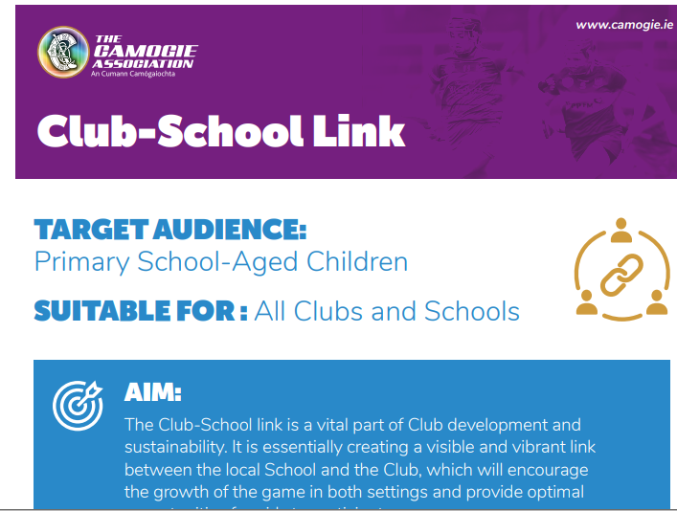
Club School Links
What Is It?
A relationship built between school and club to work together to help young girls to be involved in the game of camogie. *This doesn’t always mean just coaching*
Why Have One?
Make your camogie club known to the students of the local schools.
Be present in the community environment
Provide opportunity for girls to get involved in the game in a safe, skills based, fun focused way
Help the school to reach Green Flags, and help the club recruit players/provide additional skill development and recruit parents/coaches.
What Can It Look Like?
Coaching
-6 week block
1 session every 2 weeks
Shared Facilities
-School for club nights
-Club for school sports day
Events/Talks
-Annual Visit
-Health Week
Games Programme
-Lunch League
Teacher Games

Slide 3
IDENTIFY
ORGANISE
CONNECT
ACT
LINK
Identify Schools in Your Catchment Area
Recruit reliable, enthusiastic helpers/coaches
Link back to the club
Write/Call/Visit the school principal or PE Coordinator
Commence coaching at preferred time
School Database – what schools can you realistically get to in the time
Each person knows their role and responsibilities.
Decide what the school is willing to partake in e.g coaching/visits/ events/facilities
Ensure notice board is updated.
Look at addition of school league/parish league etc
Host a: Club/School Day
Recruitment Day
Parents Day

Slide 4
Case Study 1
Club agreed to run CSL in 2 local primary schools Principals on board with coaching session 1 day a week for junior classes & 1 day a week for older classes Coach delivered 2 sessions a week for 4 weeks Once complete visits stopped and club scene took up the majority of time.
Case Study 2
Club agreed to run CSL in 2 local primary schools Principals on board with coaching session 1 day a week for junior classes & 1 day a week for older classes Coach delivered 2 sessions a week for 4 weeks **Once 4 weeks complete – club ran a parish street league for all schools in the area with help of local TY’s from Sec School **Recruitment & Parent night ran within the club before club scene took off.
Result: 8 new club member School received it’s Green Flag CSL programme moved onto other school in 2022
Result: **15 new members within the club. **3 teenage players re-joined the club **Ran successful parent night **Recruited 3 new female coaches School received it’s Green Flag CSL programme continued into 2022 with addition of 1 more school within the catchment

Slide 5
Key Points
Know what success is for YOUR club.
It’s easy have a club school link – having a successful one is the challenge set here today
How will you measure your club school link’s success – duration, engagement, feedback, registration numbers??
Be Consistent in Delivery of Coaching
Principals/teachers like consistency and planning
Step 5 is AS IMPORTANT as Step 1 – common downfall of many club efforts is the final step.
Make your club IMPOSSIBLE NOT TO SEE!!!
Think outside the box – especially in Covid times
e.g Virtual camogie, camogie school online challenges, virtual tour of club etc

Slide 6
Resources to Assist You
School Database | List of all primary, secondary, all girls schools in the county – ascertain who is in your catchment area. | Resource available from Camogie Association development staff and your County Development Officer *Will be re-sent to County DO’s post forum
GAA Staff assigned | GAA staff known as GDA’s, GDO’s, or GPO’s are assigned a rota of schools to deliver GAA Coaching. Checking in with them is useful in introductions/rapport/planning/delivery | Resource available from Camogie Association development staff and your County Development Officer *Will be re-sent to County DO’s post forum
Join Camogie Poster | A simple poster for the school and clubs noticeboards | Available online on www.camogie.ie *Will be sent to all attendees post forum
Scheduling Sheet | Sample Schedule sheet for coaching delivery | *Will be sent to all attendees post forum
Evaluation Sheet | Sample evaluation of programme for club & school | *Will be sent to all attendees post forum

Slide 7
